Slide 1
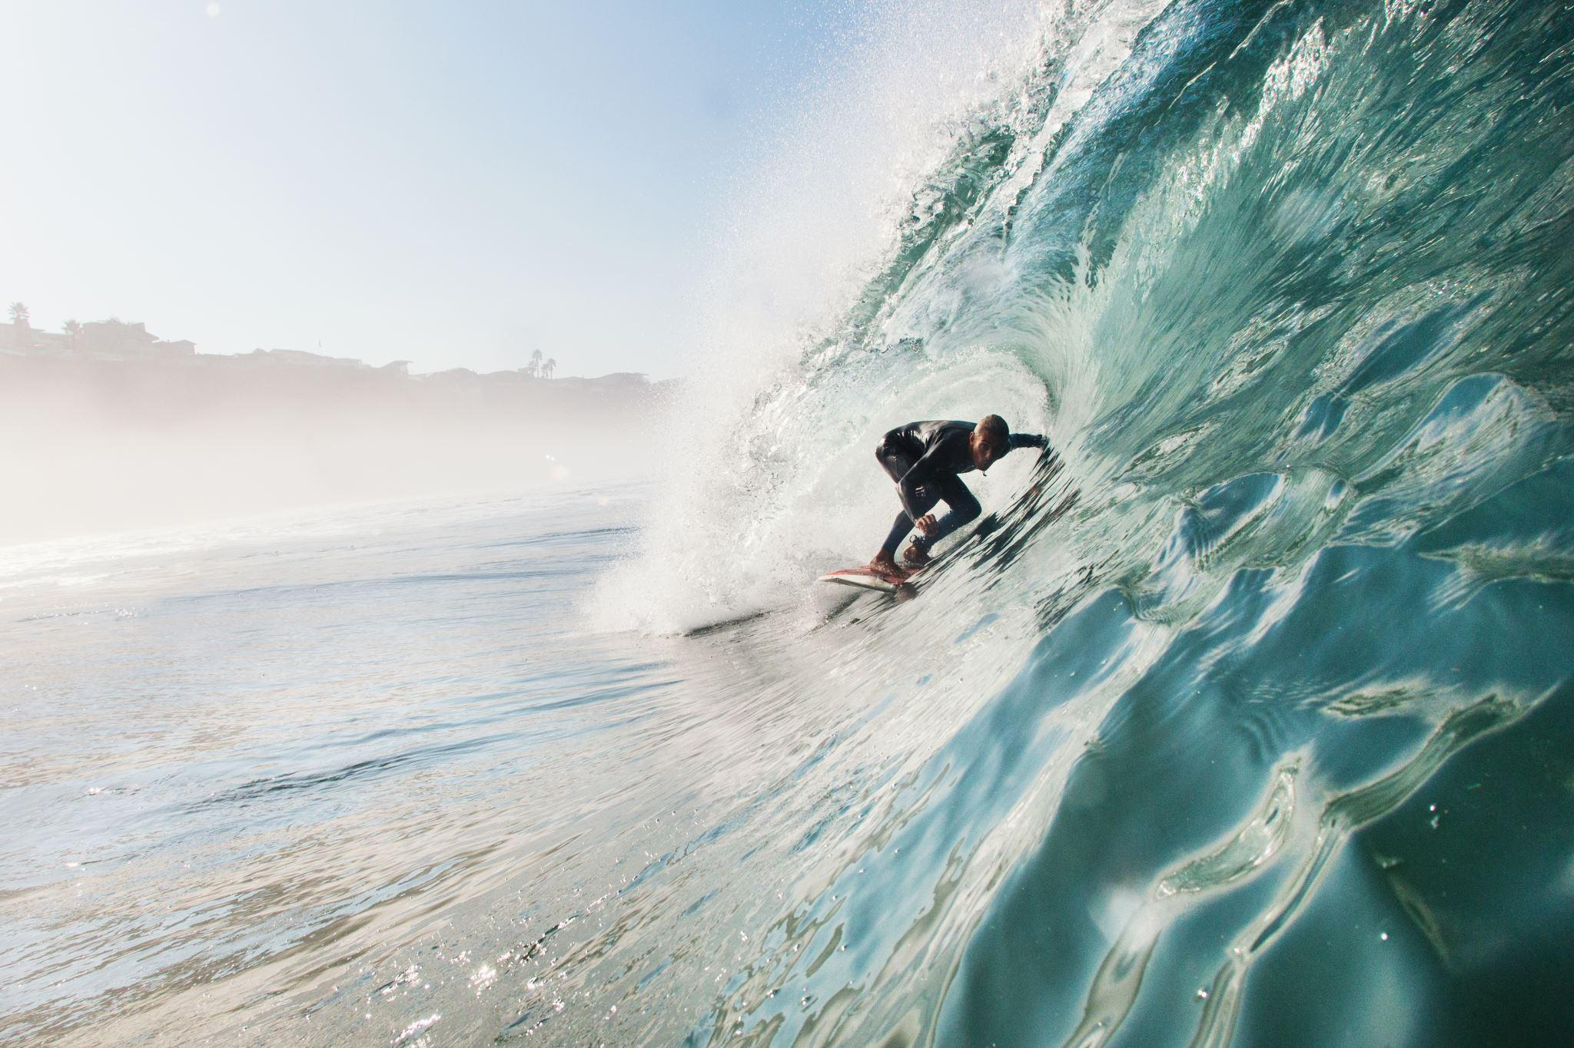
Shark attacks
A bite of advice for safe vacations!

Slide 2
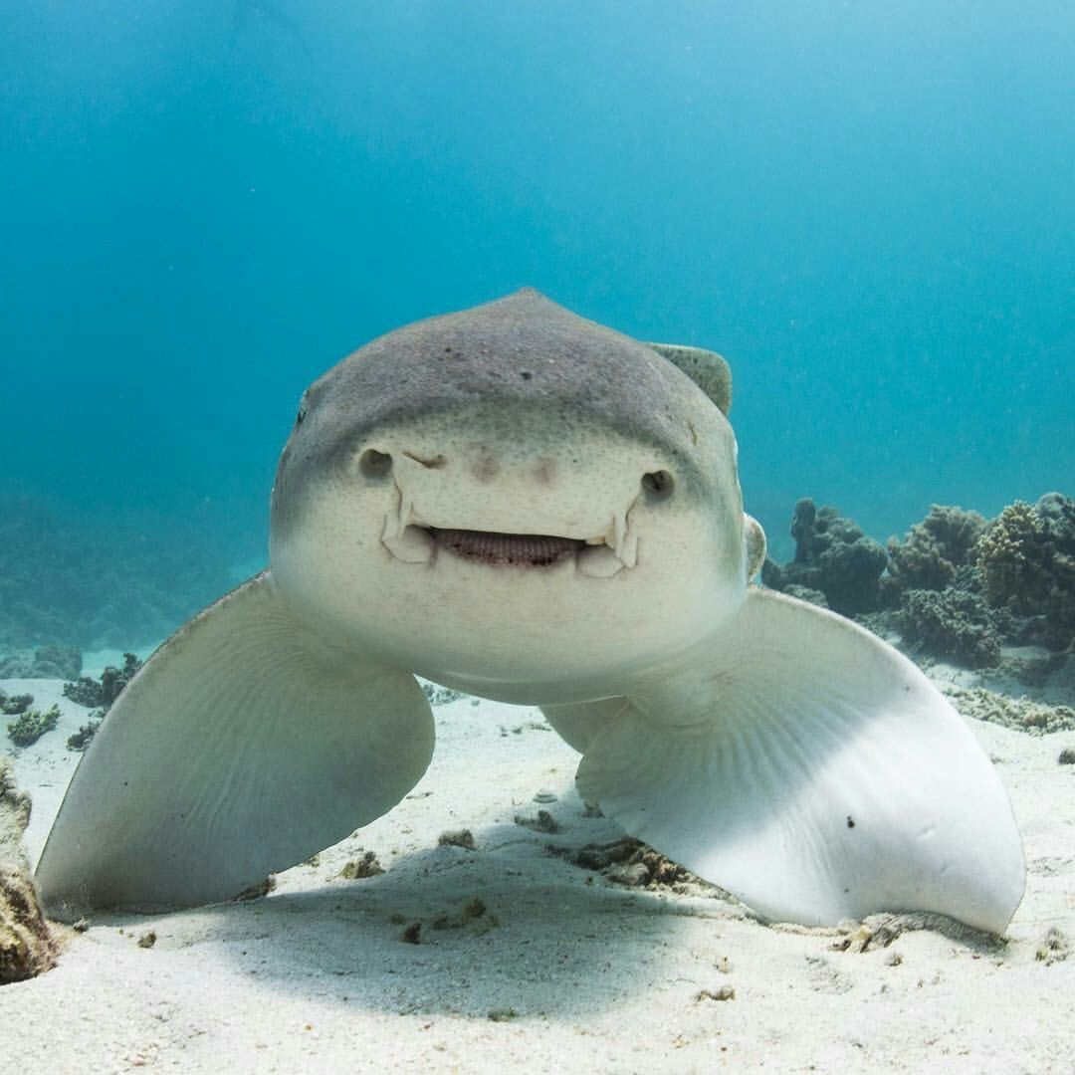
Index
Topic and Target Audience
Data processing
Test Cases
Database Integration
Machine Learning Model
Recommendations

Slide 3
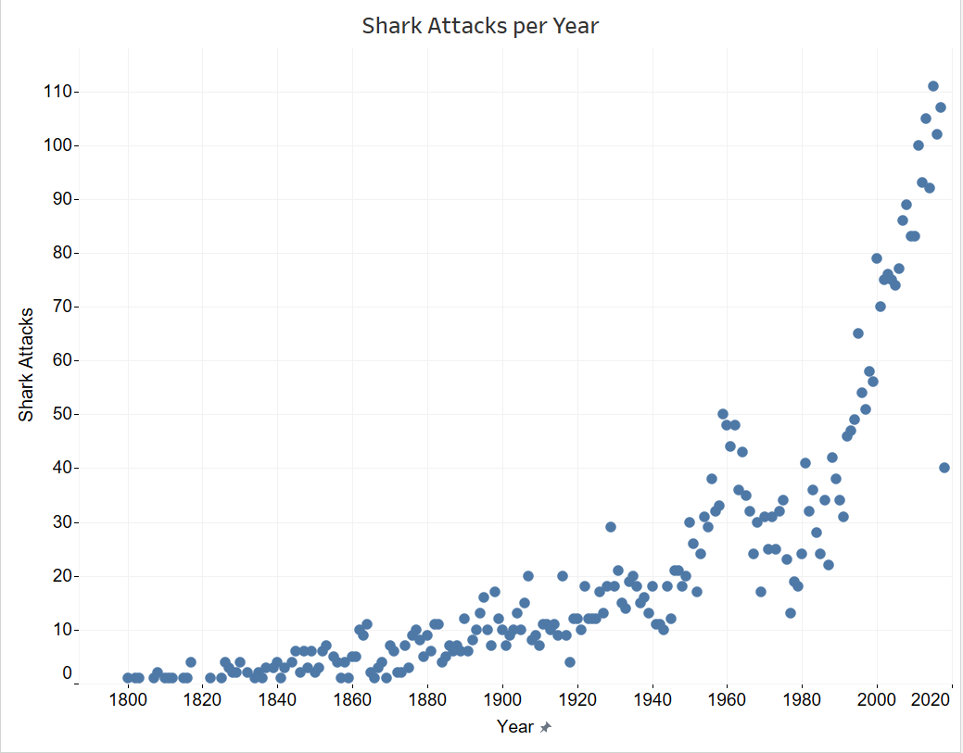
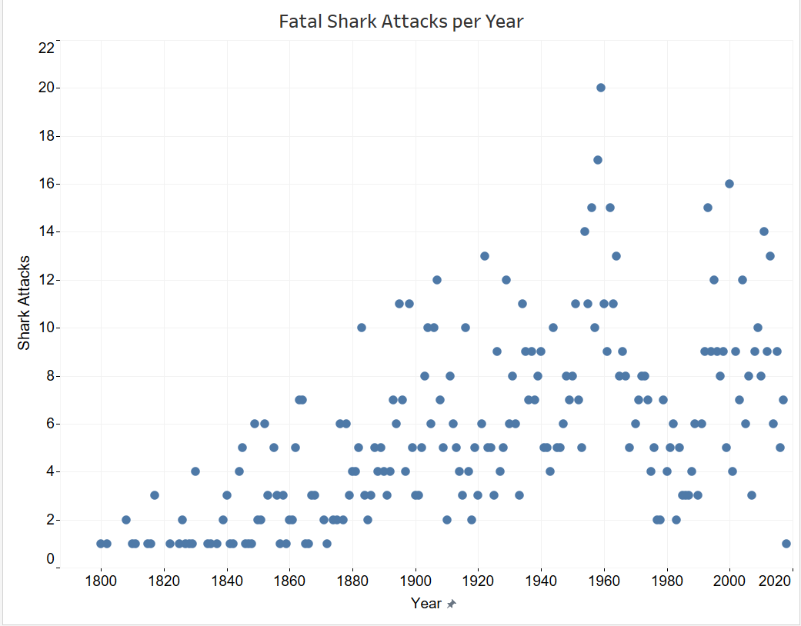
Topic and target audience
Data shows the risk of a shark attack is very low. However, there is a perception that it occurs frequently.
Our goal is to increase our customer awareness of the factors associated with unprovoked instances.
In this analysis we explore which features may have a greater impact on fatal shark attacks.
Notes:
There is risk associated with all ocean activities and while the risk of a shark attack is very low, it still occurs fairly frequently.
With this information we hope to increase our customer awareness of the reasons associated with unprovoked shark bites,
Determine which factors contribute toward the attack having a fatal outcome and educate swimmers on ways to reduce their risk of being bitten by a shark.

Slide 4
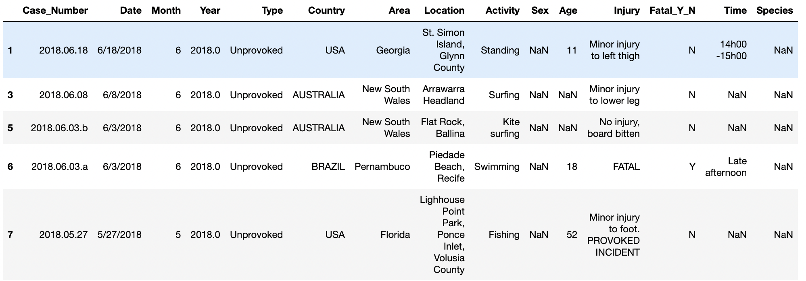
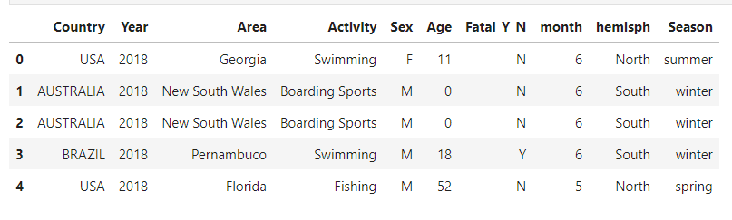
Data processing
Before
We decided to focus on the most recent attacks, from the year 2000 until 2018
After
Notes:
Data was cleaned to eliminate irrelevant variables. Text features were converted into numeric data and the encoded values were scaled before storing the data in the database and to be used by the model.
In the process we came across of several challenges due to the quality of the data. Bins were created to group the activities in which victims were involved at the moment of the attack. Besides, the month was extracted from the case number, rather than the date column, due to the inconsistencies of the data types in that column.
Null values in the activities, age and sex columns were replaced by other, 0, and unknown, respectively.

Slide 5
Test Case
Fatality: (Y) Dependent variable
Type: unprovoked
Country: World wide
Year: 2000 to 2018
Month: 1 to 12
Activity: Created overarching bins
Area
Sex: Male, Female and Unknown.
Hemisphere:North & South
Age
Season: Winter, Spring, Summer & Fall

Slide 6
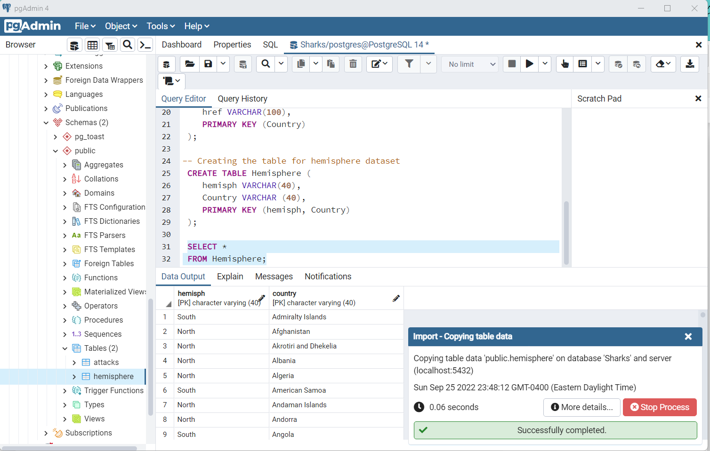
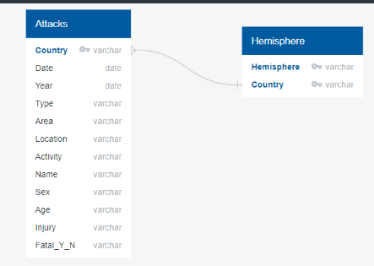
Database Integration
STEPS:
To clean the Raw attacks dataset in Jupyter Notebook.
Creation of tables in Postgres SQL server: Table attacks and Table hemisphere
To join the two tables by an inner join. The new table will be processed in Jupyter notebook (adding the season feature)
To store the table to be used for the model in the database.
To integrate the database to the model.
To store the model results in the database.

Slide 7
Machine Learning Model
Logistic Regression Analysis to identify significant features
Target: Fatal_Y_N
Features: Nine
Random Forest Classifier
Confusion matrix

Slide 8
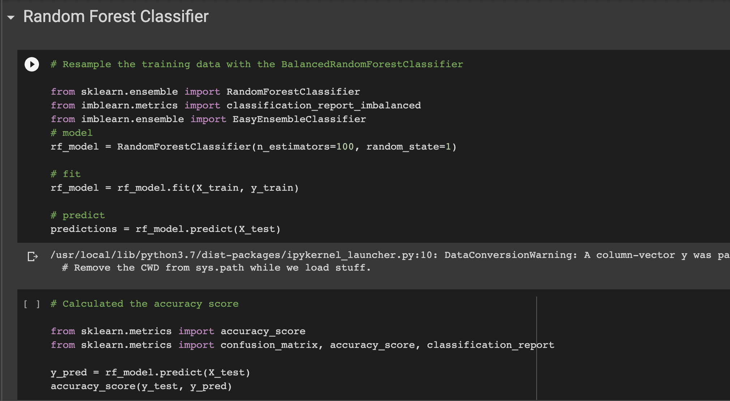
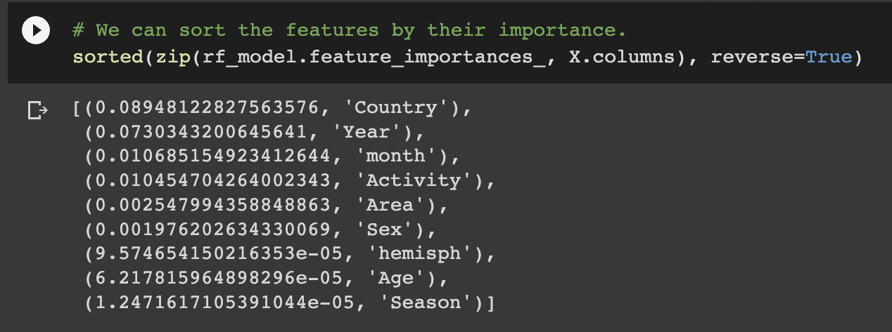
Machine Learning Model
Coding snippets

Slide 9
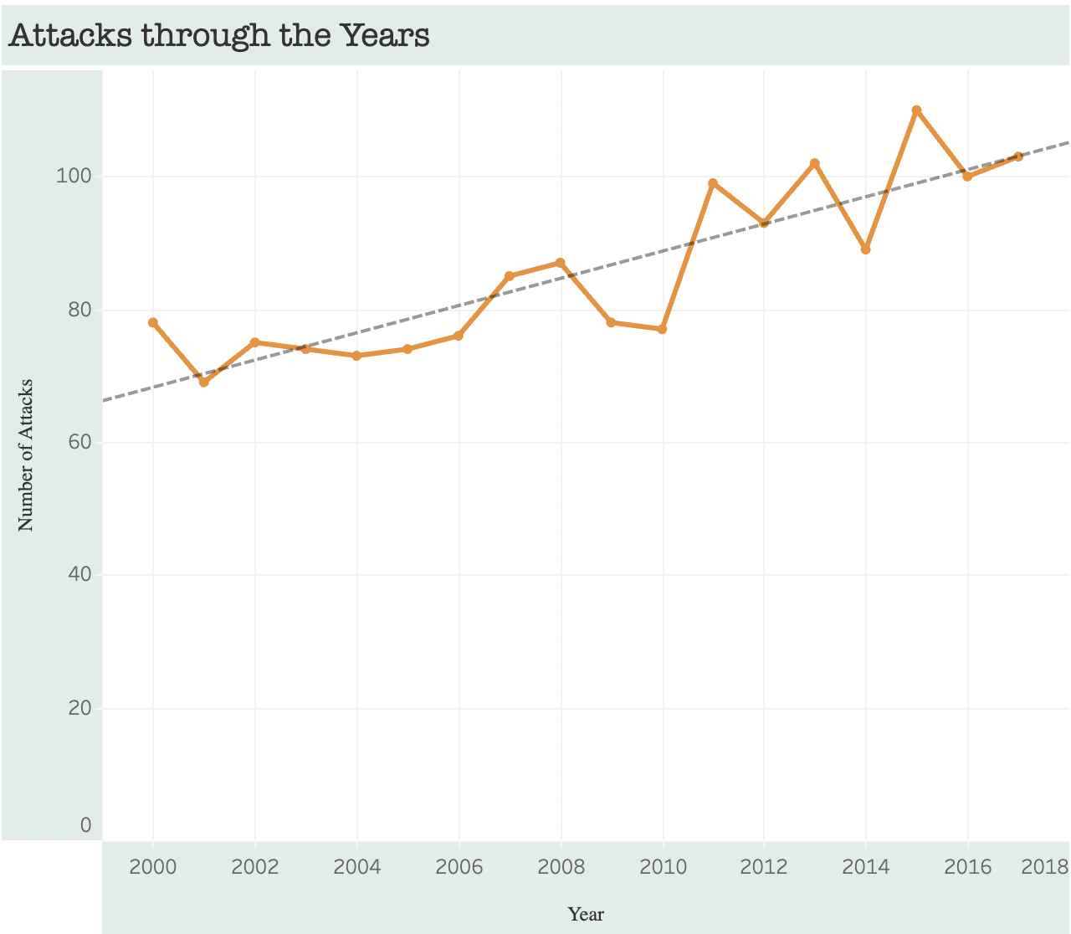
Tableau
Charts and graphs, using filter options to add interactivity
Pie chart of attacks per water activity
Interactive map/ locations where attacks occur (data permitted)
Table with results from the model

Slide 10
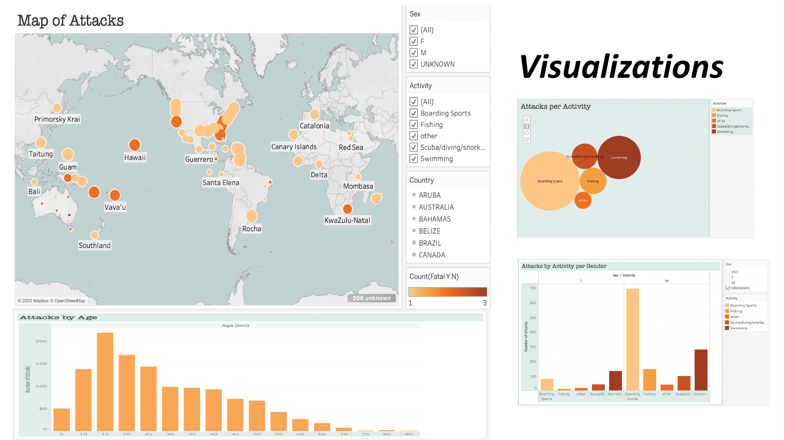

Slide 11
Recommendations
Getting customers to overcome their fears that impact travelling decisions.
Expand our customer base by creating a website to offer our services
What we would have able to accomplish or improve if we would have had more data.
Educate people on how to prevent shark attacks. What are the main contributors of Shark Attacks.
With more data and standardized data documentation more contributors for shark attacks could be identify

Slide 12
Recommendations
To help travel agencies to be able to target their customers who look for adventurous travel experiences with better campaigns based on data
More time and resources that make possible to identify if there are factors related to climate change, migration patterns that impact sharks attacks.

